Slide 1
& The Nervous System Do Now: (Worksheet)
In you opinion, what is the easiest way for you to learn? (Circle all that apply)
Learning a song about the topic
Drawing pictures and charts
Reading about the topic
Writing about the topic
Talking to people about the topic
Do something with my hands
Becoming invested in a cause and changing it!
Why do you think this is one of the best ways for you to learn?

Slide 2
We all are a different type of “smart”
Theory of Multiple Intelligence states that there are different ways to learn and everyone is unique in which way they learn best.
Several types of smart are:
Kinesthetic (body smart)
Visual (Picture smart)
Musical (music smart)
Interpersonal (people smart)
Intrapersonal (self smart)
Linguistic (word smart)

Slide 3
& The Nervous System
In your notebook!
Nervous System is the organ system that controls all of our body, it is the system that is responsible for all of our senses, feelings and thoughts.

Slide 4
WHAT PARTS DO YOU KNOW THAT ARE IN THE NERVOUS SYSTEM?
Brain
Spinal Cord
Peripheral Nerves

Slide 5
Organization of the Nervous System
Cells – Neurons
Tissue – Nervous Tissue
Organs – spine, brain
Organ System – Nervous System

Slide 6
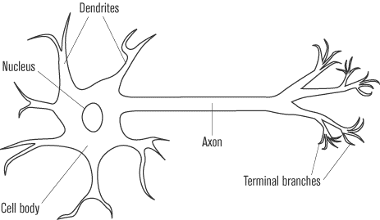
The Neuron
Input
Output
http://www.youtube.com/watch?v=-SHBnExxub8

Slide 7
How Do Neurons Learn?
Activity….
I order to play the neuron game we need to follow expectations.

Slide 9
In your notebook…
What was this activity modeling?
When we all held hands How was it like your brain learning a new skill?

Slide 10
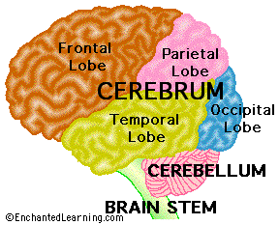
The Brain is made up of neurons

Slide 11
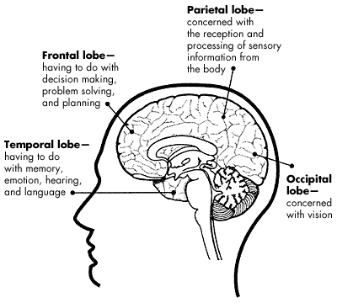
Parts of the Cerebellum

Slide 12
Learning Portal
First Learning Portal task! Yay

