Slide 1
& Observations, Inferences and Hypotheses
Do Now: Complete quiz on center of the table SILENTLY.

Slide 2
&Observations, Inferences and Hypothesis
The scientific method is important because it helps us find unbiased answers to life's questions.

Slide 3
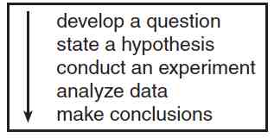
Basic Steps of the Scientific Method

Slide 4
Important Types of Statements

Slide 5
Qualitative vs. Quantitative Observations
Qualitative observations are observations that are made with your five senses.
  The peach smelled sweet.
Quantitative observations are observations made as measurements and quantities.
  The peach had a circumference of 20 cm.

