Slide 1
Welcome to
HOSPITAL
Do Now: Worksheet on your desk.

Slide 2
Review Do Now:
Do you know your genotypes?
When your patients come to you today you need to know these terms to solve their dilemma.
Homozygous dominant
Homozygous recessive
Heterozygous

Slide 3
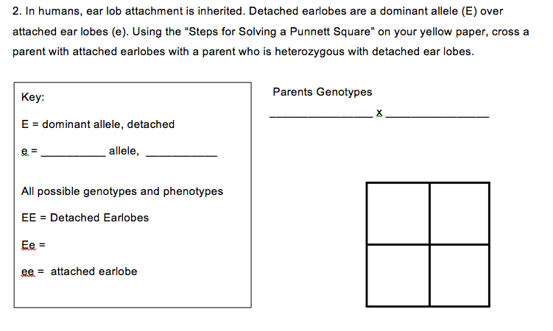
How to Solve Punnett Squares
HOSPITAL
ee
Ee
recessive
attached
sperm
egg
E e
e
e
E
e
e
e
Detached
E
e
e
e

Slide 4
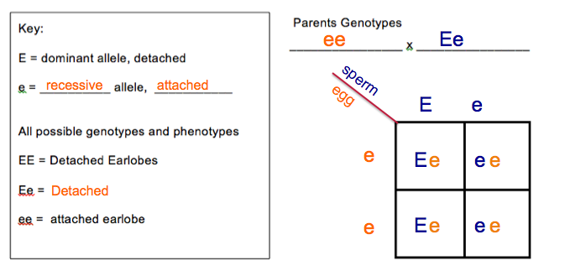
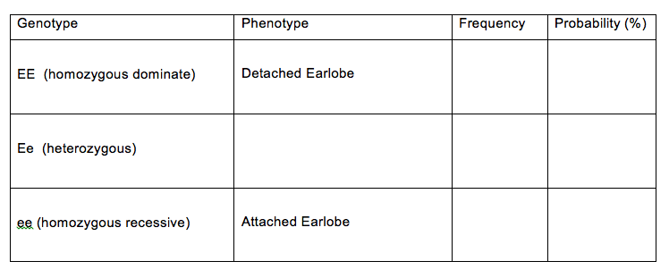
Genetics & Probability
0:4
0%
Detached
2:4
50%
2:4
50%

Slide 5
Genetic Counseling Project
Today you are Genetic Counselors, doctors and medical professionals who advise your families on certain rained to help families understand genetic disorders and to provide information and support to those families.

Slide 6
Genetic Counseling Project
Your chief (the boss of a medical department) will be evaluating your performance at ever step. The Chiefs want to make sure that the families that are coming to you for advice are getting accurate information and that the families understand how you came to your conclusions.
Each team of doctors will be visited by a couple that plans on having a child. Your team will have answer their questions and present your research to them. Here is what needs to be present in each of your reports.

Slide 7
Team Work and Hard Work…
USE THIS TO GUIDE YOUR WORK!

