Slide 1
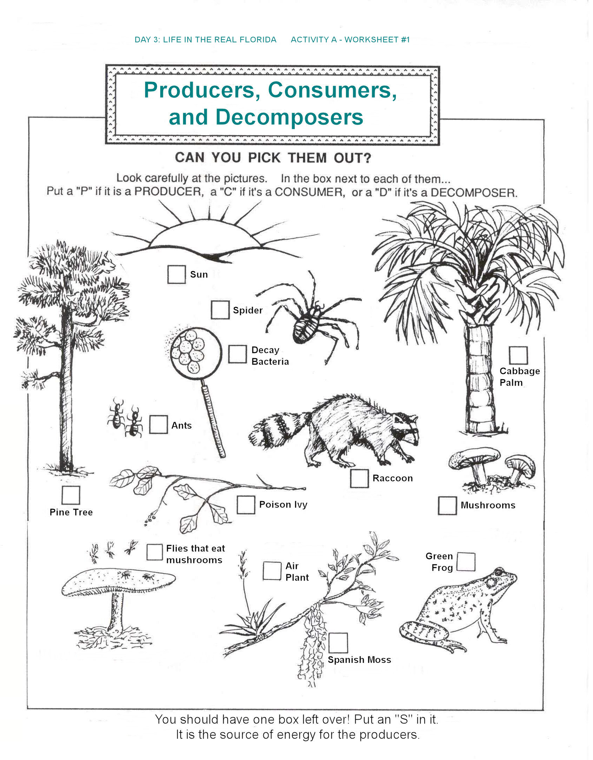
Name: _______________________________________________ Date:_____________________
Base Group Teacher: _____________________ Lab: _________
Week 11: Green Grow Packet
Goal: I can understand how a genetically modified crop could affect a food web.
Tasks:
Read and annotate “Green Genetics”
Transfer your food web to the energy pyramid
Predict and explain the changes to your food web if Quick Grow Grass was used in your town
Prepare your argument for or against Green Genetics coming to your town.
Do Now:
Vocabulary
Algae bloom: Where there is too much algae in a marine ecosystem. It reduces the oxygen in the water and kills aquatic life.
Genetically modified: an organisms whose genes were purposefully changed so that the organism will have different traits.
Native species: A species that naturally occurs in the ecosystem
Invasive Species: a non-native species that can disrupt the ecological balance.

Slide 2
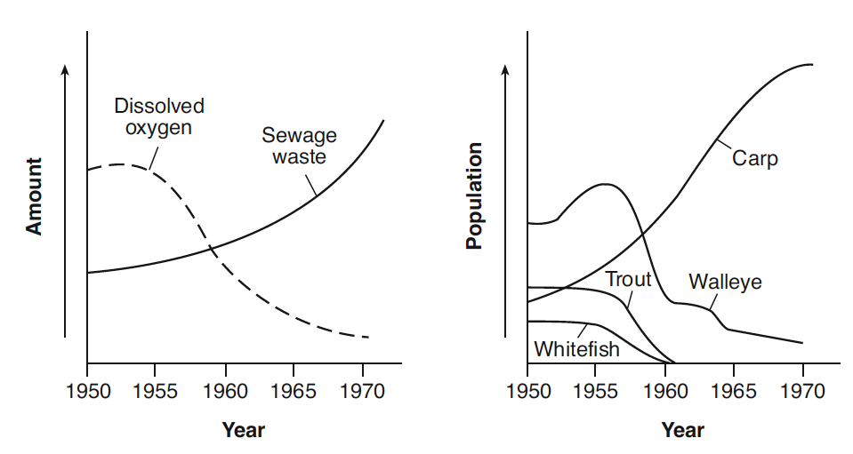
Note: Dissolved oxygen is oxygen (O₂) that is dissolved in the water. Like us fish need O₂ for cellular respiration (the opposite of photosynthesis).
The graphs below show dissolved oxygen content, sewage waste content, and fish populations in a lake between 1950 and 1970.
State what happened to the amount of dissolved oxygen and the number of fish species
as the amount of sewage waste increased. [1]
_______________________________________________________________________
_______________________________________________________________________

Slide 3
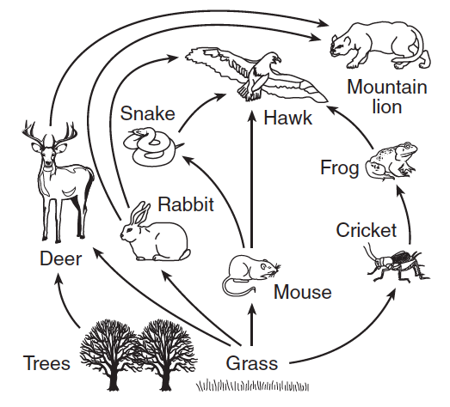
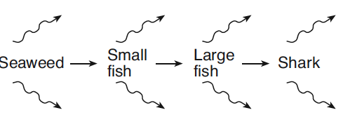
Base your answers to questions 1 and 2 on the food web below and on your knowledge of biology
Note: Dissolved oxygen is oxygen (O₂) that is dissolved in the water. Like us fish need O₂ for cellular respiration (the opposite of photosynthesis).
The graphs below show dissolved oxygen content, sewage waste content, and fish populations in a lake between 1950 and 1970.
1 Which organisms are carnivores?
(1) grass and trees (3) deer and mountain lion
(2) mouse, rabbit, and cricket (4) frog, snake, and hawk
2 A decrease in the grass population will most immediately decrease the available energy for the
(1) Mouse (3) snake
(2) Hawk (4) frog
4. State what happened to the amount of dissolved oxygen and the number of fish species as the amount of sewage waste increased. [1]
____________________________________________________________________________________________________
__________________________________________________
3 A food chain is illustrated below.
The arrows represented as most likely indicate
(1) energy released into the environment as heat
(2) oxygen produced by respiration
(3) the absorption of energy that has been synthesized
(4) the transport of glucose away from the organism
5. Which method of protecting members of an endangered species is most ecologically sound?
(1) protecting the habitats where these animals live from human development
(2) capturing these animals and putting them in wildlife parks
(3) feeding and constructing shelters for these organisms
(4) passing laws that encourage hunting of the predators of these species

Slide 4
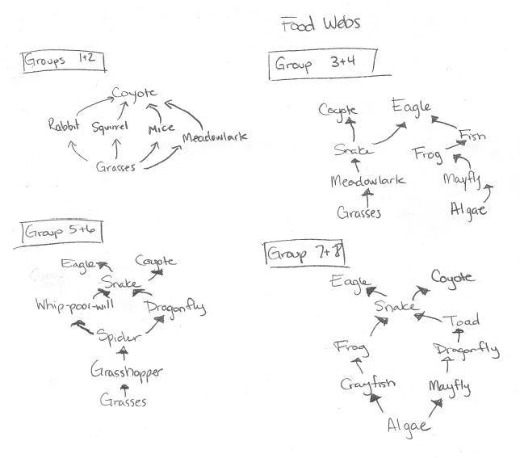

Slide 5
Directions: Using the food web you completed fill out this energy pyramid.
Name: _______________________________________________ Date:_____________________
Base Group Teacher: _____________________ Lab: _________
Quaternary Consumers
Tertiary Consumers
Secondary Consumers
Primary Consumers
Primary Producers

Slide 6
Directions: Using the food web you completed fill out this energy pyramid.
Name: _______________________________________________ Date:_____________________
Base Group Teacher: _____________________ Lab: _________
Tertiary Consumers
Secondary Consumers
Primary Consumers
Primary Producers

Slide 7
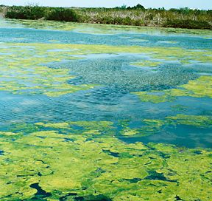
Green Genetics:
Should the company Green Genetics come to your town?
Green Genetics wants to set up a lab in your town and provide people with genetically modified grass. The town is excited to have a company that would bring jobs and pay a lot of taxes that could be used to protect the environment and fund schools. However, there may be more disadvantages than advantages if Green Genetics comes to your town.
In your town, many lawn owners were complaining that their lawns were being consumed the wildlife. They wanted to have lush green grass that would grow but would not be consumed by animals. A company called Green Genetics created a genetically modified species of grass called Quick Grow Grass.
Quick Grow Grass easily reproduces and cannot be consumed by the animals. Green Genetics boasts that their grass will grow quicker than the native grass, with out the use of fertilizer, and will not be destroyed by the wildlife looking for a meal. However, some environmentalist are worried about having a non-native species that can not be consumed brought into their ecosystem.
Should we use Quick Grow Grass?
Advantages | Disadvantages

Slide 8
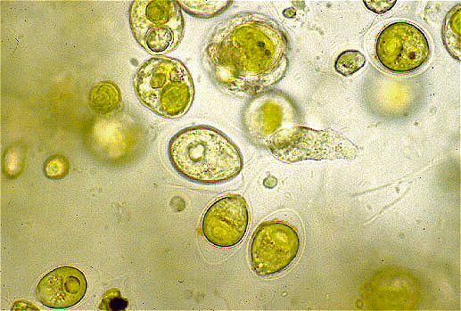
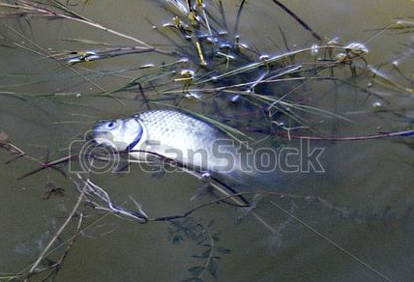
Green Genetics:
Should the company Green Genetics come to your town?
Algae bloom
Some plants grow some die
Currently, lawn owners have have been using fertilizer on their lawns and it has been getting into the local marine ecosystems. When there is an excess of fertilizer in the water it causes and algae bloom, where the algae grows very quickly and covers the lake area. As more algae and plants grow, others die. This dead organic matter becomes food for bacteria that decompose it. With more food available, the bacteria increase in number and use up the dissolved oxygen in the water. When the dissolved oxygen content decreases, many fish and aquatic insects cannot survive. This results in a dead area. Quick Grow Grass claims that there grass will require little do no fertilizer so the algae blooms will stop.
Your ecology team has been asked to study the impact of using this grass in your local ecosystem. You must consider how it might affect the population of each organism in your food web if the grass populates beyond lawn. Using the information you assembled you must be ready to argue for or against Green Genetics product.
First, use the food web and the chart on the next page to predict what will happen if Quick Grow Grass is used instead of the native grass.
Bacteria (decomposers) population increases
Bacteria use up the dissolved oxygen in the water.
Not enough dissolved oxygen in the water kills fish and aquatic insects.

Slide 9
What will happen if the town uses Quick Grow Grass instead of using the native grass?
Directions: Fill out each type of species in your food web under population. Then predict if the population will increase, decrease or remain the same in predicted change. Explain why the population will or will not change in the column labeled “explain your prediction.”
Population | Predicted Change (Increase, Decrease or remain the same) | Explain your prediction

Slide 10
Fill out the chart below and write your argument down using the outline below.
Should “Green Genetics” build their lab and use their grass in our town?
Claim | Evidence | Reasoning
(a statement about what you understand or a conclusion you have reached from an investigation) | (Observations, events, or statements that you have found that support a claim) | (Explains how you connected the evidence or the science behind your claim)

Slide 11
Green Genetics Debate: Should the company Green Genetics come to your town?
Hook :
_________________________________________________________________________________
_________________________________________________________________________________
_________________________________________________________________________________
Claim
_________________________________________________________________________________
_________________________________________________________________________________
_________________________________________________________________________________
Evidence
_________________________________________________________________________________
_________________________________________________________________________________
_________________________________________________________________________________
Reasoning
_________________________________________________________________________________
_________________________________________________________________________________
_________________________________________________________________________________
Closing Statement:
________________________________________________________________________________
________________________________________________________________________________
________________________________________________________________________________
________________________________________________________________________________
(Introduce the problem)
I claim…
I believe…
In our investigation we found,..
Explain the science behind your claims and evidence
Therefore, I recommend that…

