Slide 1
Organism Organization
Do Now: Paper on center of table.
SILENTY

Slide 2
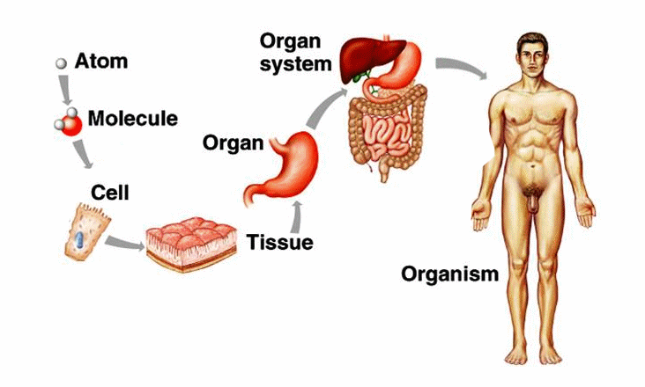
Do NOw

Slide 3
How to take notes
& or Ribbon
means that is the title of your activity. It goes into the table of contents and on top of the first page of your notes
Underlined Words
Keywords/ vocabulary you write them down in your notes and put them in your index
Notes in Gray
Optional, if you are a good note taker and aiming for a 4 or 5 these are not optional.

Slide 4
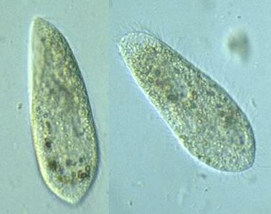
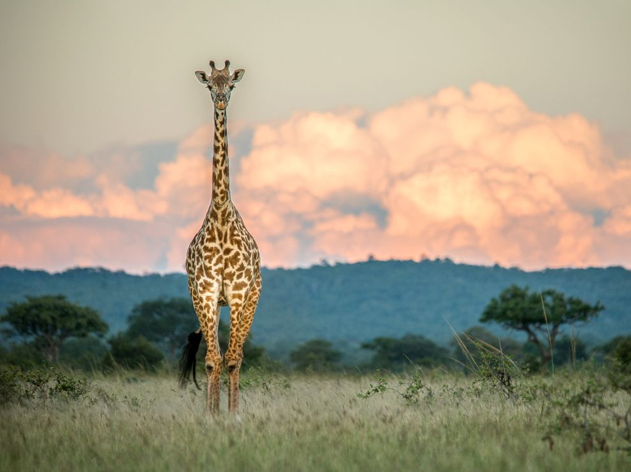
& Organism Organization
5 min
Organism is a living thing.
The 7 Characteristic of Living Things
Living things…
are made of cells.
obtain and use energy.
grow and develop.
reproduce.
respond to their environment.
adapt to their environment.
are organized.
Under “O” in your index
Organism, 1

Slide 5
& Organism Organization
5 min
Abiotic (a – without, bio – life) an object that is without life
Biotic ( bio – life) an living object
Cell the smallest unit of life.
Cell Theory: The theory that states that all living things are made up of cells.
Unicellular (uni- one, cellular – to do with cells) microorganisms that are made up of one cell.
Multicellular (multi- many; cellular – to do with cells) organisms that are comprised of two or more cells.

