Slide 1
& Animal Cell vs. Plant Cell
September 26, 2013
Do Now: Complete the Quiz that is found in the middle of your table
On your OWN and SLIENTLY

Slide 2
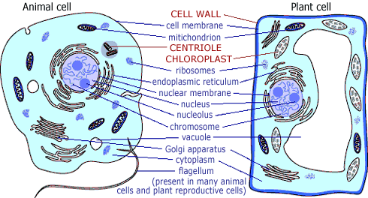
& Animal Cell Vs. Plant Cell
Plant and animal cells have several differences and similarities. For example, animal cells are round shape and plant cells are rectangle shape.

Slide 3
Animal Cell Vs. Plant Cell
The next 15 minutes you are reading silently
Please read at least one of the readings
Take your time and find the differences between a Animal Cell and Plant Cell by ANOTATING.

Slide 4
Check with your neighbor…
Take a few minutes to check with your neighbor what differences you have annotated.
What do you have that is different?
What do you have that is the same?
Take 7 to 10 minutes to copy your notes into your notebook.

Slide 5
Foldable - DIRECTIONS
1.) Fold in half
2.) Cut on the dotted lines
3.) Inside, under Animal Cell, write what organelles are found in an Animal Cell
4.) Inside, under BOTH, write what organelles are found in BOTH animal cell and plant cells

Slide 6
Foldable DIRECTIONS, continued
5.)Inside, under Plant Cell, write what organelles are found in a Plant Cell.
6*.) *if you have time* color the organelles in both the animal and plant cell.
EXAMPLE: Color any Ribosomes in both cells RED
Color the Mitochondria in both cells PURPLE

Slide 7
Foldable
Animal Cell: BOTH Plant Cell:
- Round Shape - Cytoplasm - Rectangular Shape
Vacuole - Endoplasmic - One Vacuole
Cell Membrane Reticulum - Chloroplast
- Lysosomes - Ribosomes - Mitochondria - - Golgi Apparatus
- Nucleus

Slide 8
Conclusion
Log books OUT open to week 40

