Slide 1
What is Genetic Material?
All organisms, living things, are made up of cells.
Each cell has a nucleus that contains genetic information.
Genetic information is stored in a molecule called DNA.

Slide 2
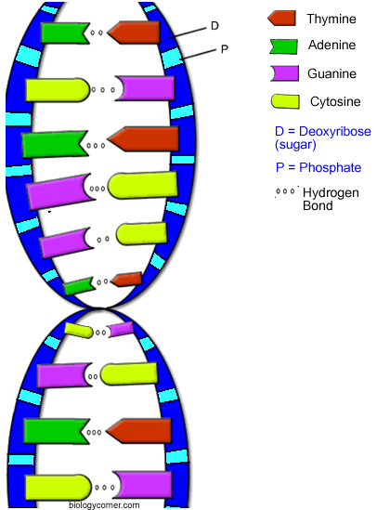
& Genetic Material
The instructions for life are like a blueprint or a computer program. Instead of paper or electrical signals the code for life is stored in a very long molecule.
This molecule is called deoxyribonucleic acid (DNA) it is located in the nucleus of a cell.
Is in the shape of a double helix.
Many compare it to a twisted ladder. The steps are made up of four nucleotides.
They fit together like a puzzle.
Adenine (A) matches Thymine (T)
Guanine (G) matches Cytosine (C).
Fill in the diagram to the right. Match the base pairs or nucleotides

Slide 3
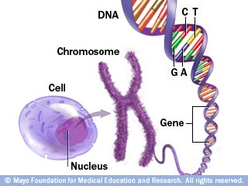
When DNA unwound it is over 6 feet long! It is found in all cells (expect red blood cells).
Since it is so long it needs to be wound in tight bundles like yarn. These tightly wound strands of DNA are called chromosomes
.
Chromosomes are made up tightly wound DNA. Different species have different number of chromosomes. Chromosomes are located inside the cells organelle called the nucleus.
Humans have 46 chromosomes or 23 pairs of chromosomes.

Slide 4
Now try this.
1. C C G T C G T C A C T 2. T T A G C T A G T C A
__ __ __ __ __ __ __ __ __ __ __ __ __ __ __ __ __ __ __ __ __ __

Slide 5
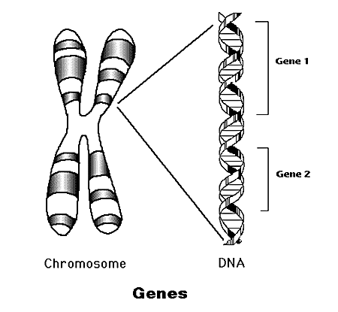
Specific parts of DNA code for genes. On the chromosomes you can find the DNA that codes for genes next to each other like a band.
Each half of the “X” shape is one chromosome. You get one half from each parent in sexual reproduction.

Slide 6
Sex cells (the sperm and the egg contain half the amount of chromosomes as the body cells.
The data table below shows five hamster species and the number of chromosomes found in their body cells
3. These species all reproduce sexually. How many chromosomes would be in a sex cell of a Syrian hamster? ____________ chromosomes
4. How many chromosomes would be in a sex cell of a Robovski Hampster ____________ chromosomes

Slide 7
& How do scientists study traits?

Slide 8
& How do scientists study traits?
Inherit: to receive traits from previous generations
Expressed (to express): shown

Slide 9
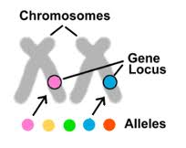
Each pair of chromosomes have two genes. One specific gene is called an allele. An allele is a singular gene that codes for a trait.
You can have a gene that codes for eye color but the alleles would be brown, green, blue or hazel.
When two alleles come together in sexual reproduction you get a genotype.. When we describe genotypes we use letters.

Slide 10
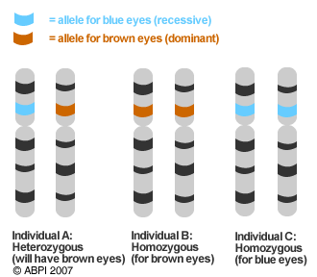
Genotypes
Alleles can be recessive or DOMINATE.
A dominate allele has a gene that is always expressed. It masks a recessive allele. It is represented by a capital letter (B).
A recessive allele is only expressed if there is no dominate allele paired with it. IT is represented by a lower case letter (b).

Slide 11
You can describe genotypes in three ways: (remember heter-different, homo- same).
Heterozygous describes a genotype that has a recessive and a dominate allele. (Bb, Hh, Tt)
Homozygous dominate describes a genotype that has two dominate alleles.
(BB, HH, TT).
Homozygous recessive describes a genotype that has two recessive alleles.
(bb, hh, tt).

Slide 12
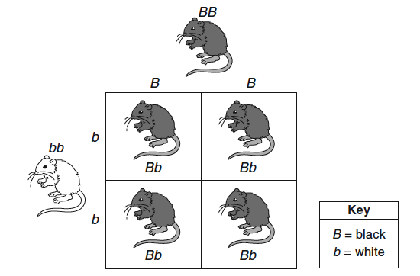
Phenotypes describe how the genotype is expressed or looks.
The allele is
Dominate – B
Recessive - b
The genotypes are BB, Bb, bb.
Phenotype is black or white fur

Slide 13
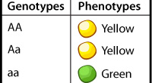
Phenotype
A phenotype is how that gene is expressed. We can observe phenotypes.

Slide 14
Dominate alleles mask the recessive alleles.

Slide 15
Genotypes and Phenotypes
Genotypes | Phenotype
BB (H | Black
Bb | Black
Bb | White
Dominate masks the recessive

Slide 16
Genotypes and Phenotypes
Key:
____ = Dominate (________________)
____ = Recessive (________________)
All possible genotypes and phenotypes
____ =
____ =
____=
B
Black Fur
b
White Fur
BB
Homozygous Dominate, Black Fur
Bb
Heterozygous, Black Fur
bb
Homozygous recessive, White Fur
Genotypes | Phenotype
BB | Black
Bb | Black
Bb | White
Dominate masks the recessive

Slide 18
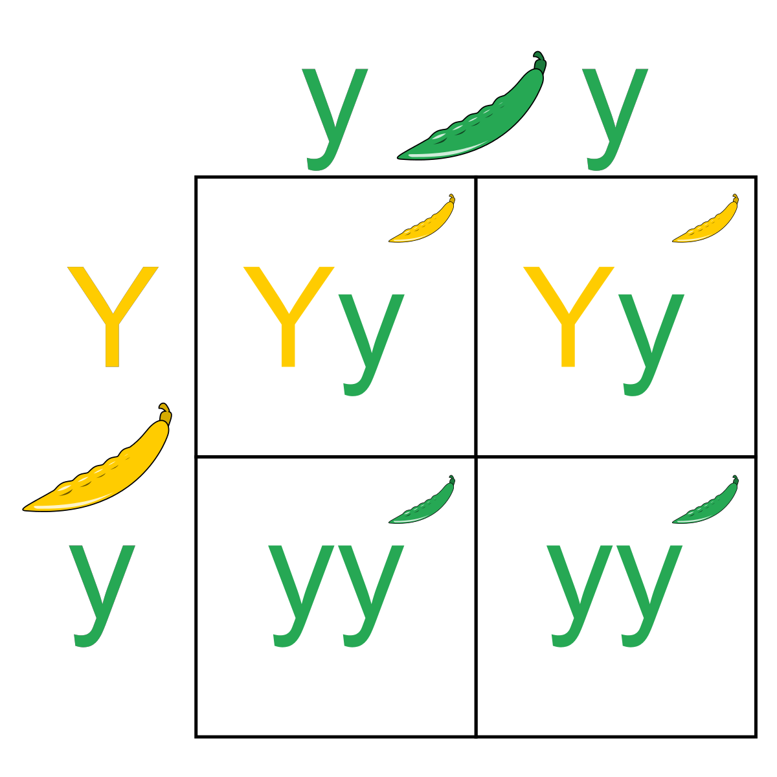
Genotypes and Phenotypes
Key:
____ = Dominate (________________)
____ = Recessive (________________)
All possible genotypes and phenotypes
____ =
____ =
____=
Y
Yellow Pod
y
Green pod
YY
Homozygous Dominate, Yellow Pod
Yy
Heterozygous, Yellow Pod
yy
Homozygous recessive, green pod
Explain why the heterozygous genotype (Yy) has a phenotype of Yellow pod instead of a green pod.

